Slide 1
Chapter 1
Statistics and
Data Science
Professor Jung Jin Lee

Slide 2
1.1 Statistics and Data Science
1.2 Population and Sample
1.3 Variables and Data
1.4 Software for Statistical Analysis

Slide 3


1.1 Statistics and Data Science
https://money.usnews.com/careers/best-jobs/rankings/best-business-jobs
In Google, type
‘Best Business Jobs US News
Careers’

Slide 4


1.1 Statistics and Data Science
#5 Financial Manager
#6 Financial Advisor
#7 Accountant
#8 Market Research Analyst
#9 Business Operation Manager
#10 Social and Community Service Manager
#11 Actuary
#2 Medical and Health Service Manager

Slide 5
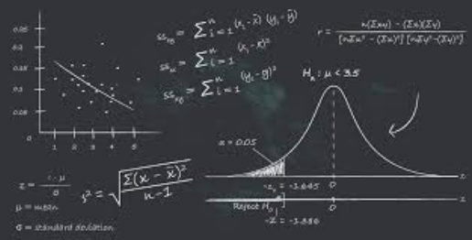

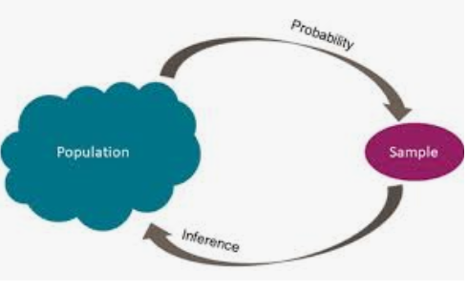
1.1 Statistics and Data Science
Statistics
Statistics = ‘State ‘ + ‘istics’

Slide 6
1.1 Statistics and Data Science
Statistics
History tells which country appeared where, when, how large its territory, how much population and how many households
- In Egypt, Greece and Rome, population and farmland area
were used for the management of their country.
8th to 13th century, concept of probability and inference
Al-Khalil (717–786), Al-Kindi (801–873), Ibn Adlan (1187–1268)
17th to early 19th century, mathematical foundations of statistics
Gerolamo Cardano, Blaise Pascal and Pierre de Fermat.
late 19th century, Francis Galton and Karl Pearson
early 20th century, Ronald Fisher

Slide 7
1.1 Statistics and Data Science
Statistics
Today, statistical methods are applied in all fields
=> decision making, accurate inferences from data
=> management, economics, politics, social science, education
physics, chemistry, biology, computer science
medical science, pharmacy, agricultural science
electrical, electronical, chemical, civil engineering
Modern computers has expedited large-scale statistical computations.

Slide 8

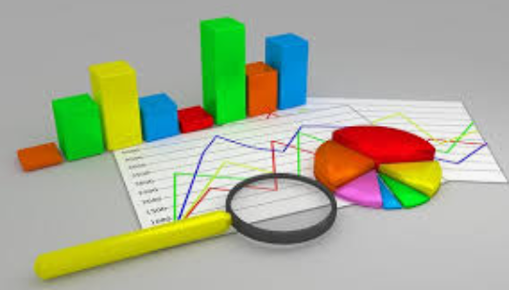
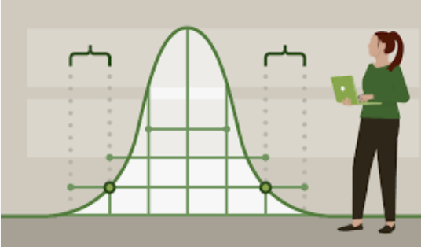
1.1 Statistics and Data Science
Statistics
Modern statistics is the discipline
=> efficiently collect data, summarize data
=> analyze data to make scientific decisions using various
probabilistic models in uncertain situations.
Company predicts sales, government establish economic development plan

Slide 9
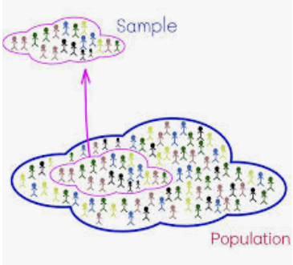

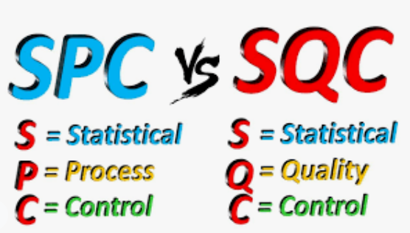
1.1 Statistics and Data Science
Application of Statistics
sample surveys to predict the winners of the election.
Test new drug by a pharmaceutical company.
Quality Control

Slide 10
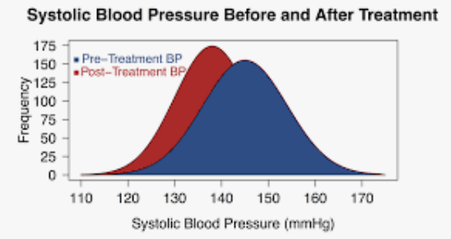
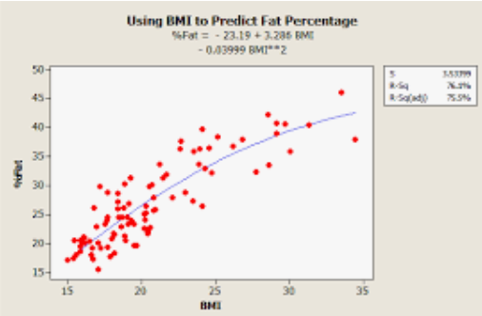
1.1 Statistics and Data Science
Application of Statistics
Examine blood pressure before and after treatment
Using BMI to predict FAT Percentage

Slide 11

1.1 Statistics and Data Science

Slide 12
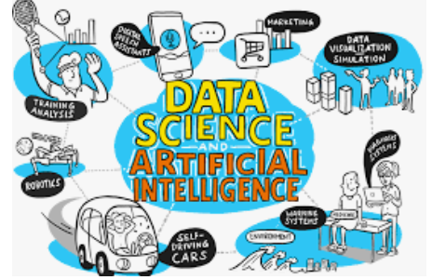

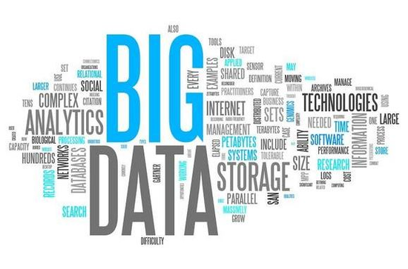
1.1 Statistics and Data Science
Data Science

Slide 13
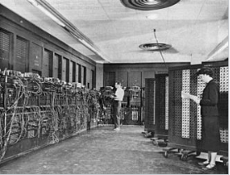
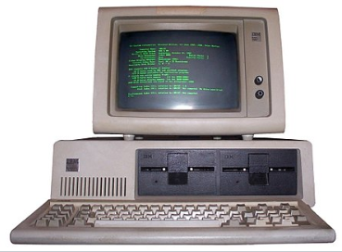
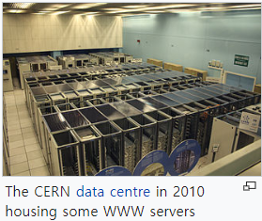
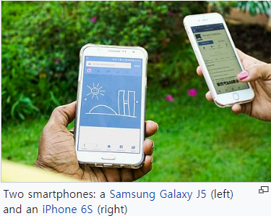
1.1 Statistics and Data Science
Rapid advance of computer and tele-communication technology
1946 Modern Digital Computer(ENIAC) by Eckert and Mouchly of Univ of Pennsylvania
1981 IBM Personal Computer
Microsoft Operating System by Bill Gates
1990s Networking of computers in the world
World Wide Web by Berners-Lee
Google search engine
Yahoo, MSN web portal
Big Data
- SNS Data
- web log data
- Bank data
- credit card data
- Health data
2000s Smartphone = PC + Phone
www + wireless connection of Smartphone
YouTube, Facebook, Twitter, LinkedIn

Slide 14



1.1 Statistics and Data Science
18th Century
1st Industrial Revolution
4th Industrial Revolution is under going by using Big Data
- Artificial Intelligence (AI)
- Internet of Things (IoT)
- Hyper-forecasting
19th –Early 20th Century
2nd Industrial Revolution
Automatic driving car
3D printing
Virtual Reality
Alpha Go
….
Late 20th Century -
3rd Industrial Revolution

Slide 15
1.1 Statistics and Data Science
Data Science is to collect big data, analyze and apply it in real life
Data Science is a fusion of several science
Probability
Estimation
Testing
Sampling
Multivariate Stat Anal
Database
Information Retrieval
Distributed Computing
Artificial Intellignece
Pattern Recognition
Machine Learning
Optimization
MIS
Marketing
Statistics
Data Science
Management
Computer Science

Slide 16
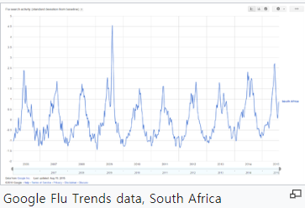

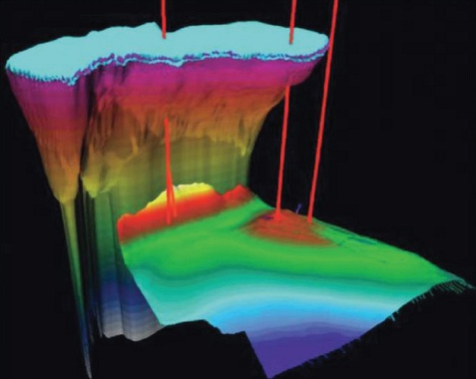

1.1 Statistics and Data Science
Example of Data Science
Google Flu Trend to estimate influenza activity
Market basket analysis
Crude oil exploration
Car insurance fraud detection
=> Introductory Statistics toward Data Science

Slide 17
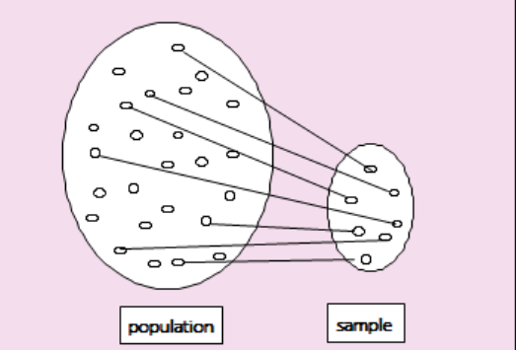
1.2 Population and Sample
Population Sample
Population is a whole set of data which we are interested in.
Sample is some number of data extracted from the population.

Slide 18
1.2 Population and Sample
Descriptive statistics with Excel, eStat
- data visualization using graphs
- data summary using frequency table and measures
- probability, distributions
Inferential Statistics by using statistical software, eStat
- sampling distribution
- estimation
- testing hypothesis
- simple linear regression

Slide 19
1.2 Population and Sample
Example 1.2.1 | The voting result for the 2016 United States Presidential Election are summarized as the following table. What field of statistics is this? Candidate Votes % Electral vote Donald John Trump (Republican) 62,984,828 46.09% 304 Hillary Diane Clinton (Democratic) 65,853,514 48.18% 227 Gary Earl Johnson (Libertarian) 4,489,341 3.28% 0 Jill Ellen Stein (Green) 1,457,218 1.07% 0 David Evan McMullin (Independent) 731,991 0.54% 0 Darrell Lane Castle (Constitution) 203,090 0.15% 0 Gloria Estela La Riva (Socialism) 74,401 0.05% 0

Slide 20
1.2 Population and Sample
Example 1.2.2 | The CNN poll was conducted from May 7, 2020 to May 10, 2020 for the 2020 United States Presidential Election by using a sample of 1001 registered voters. The result of poll was as follows. Margin of error = +/-4 percentage points. What field of statistics is this? Candidate % Donald John Trump (Republican) 46% Joe Biden (Democratic) 51%

Slide 21
1.2 Population and Sample
Chapter 1. Statistics and Data Science
↓ |  | ↓
Chapter 2. Data Visualization of Categorical Data |  | Chapter 7. Testing Hypothesis for Single Population
↓ |  | ↓
Chapter 3. Data Visualization of Quantitative Data |  | Chapter 8. Testing Hypothesis for Two Populations
↓ |  | ↓
Chapter 4. Data Summary with Table and Measure |  | Chapter 9. Testing Hypothesis for Several Populations (ANOVA)
↓ |  | ↓
Chapter 5. Probability Distribution Model of Data |  | Chapter 10. Nonparametric Testing Hypothesis
↓ |  | ↓
Chapter 6. Sampling Distribution and Estimation |  | Chapter 11. Testing Hypothesis for Categorical Data
 |  | ↓
 |  | Chapter 12. Correlation and Regression Analysis

Slide 22
1.3 Variables and Data
Data are values that observe or measure the properties of an object or event that are of interest by a given rule.
The property of these objects or events is called a variable.
- if you measured the gender and height of a college student,
there are two variables (gender and height).
Qualitative variable: Attributes of gender are 'Male', 'Female’,…
(Categorical variable)
=> frequency analysis
Quantitative variable: Height are 180cm, 165cm, 175cm, ...
=> Discrete(countable) vs Continuous(uncountable) variable
=> statistical analysis

Slide 23
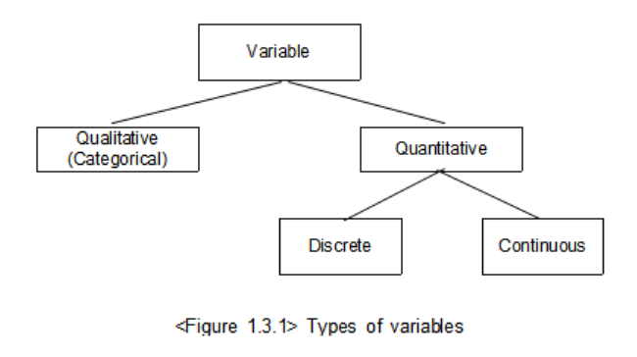
1.3 Variables and Data

Slide 24
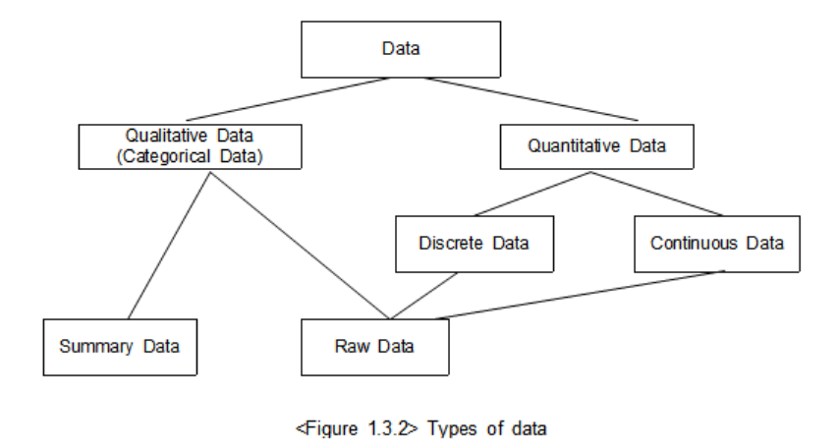
1.3 Variables and Data

Slide 25
1.3 Variables and Data
Categorical data are classified either raw data or summary data
- Raw Data of Gender - Summary Data of Gender
row | Gender
1 | Male
2 | Female
3 | Male
4 | Female
5 | Male
6 | Male
7 | Male
8 | Female
9 | Female
10 | Male
Gender | Students
Male | 6
Female | 4
‘Gender’ variable name
, ‘Male’ or ‘Female’ variable value

Slide 26
1.4 Software for Statistical Analysis
Computer software is essential for Statistics & Data Science
- Elementary: Excel
- Advanced: statistical packages such as SAS, SPSS, R, Stata
for advanced user
no educational module
expensive except R
not an web/mobile

Slide 27
1.4 Software for Statistical Analysis
eStat Development Project (2015 ~ 2018)
- by J.J.Lee and others
- freeware
- web/mobile ready - anytime and anywhere
- easy user interface
- dynamic graphs
- from elementary to university users

Slide 28
1.4 Software for Statistical Analysis - eStat
◎ Technology & Manpower for eStat
HTML5, CSS3, JavaScript
D3.js for dynamic graphs
Handson table sheet
Statistical distribution library
- include nonparametric distributions
Professors in statistics, statistical computing
Professors in mathematics education
Elementary, middle, high school teachers

Slide 29




1.4 Software for Statistical Analysis - eStat
◎ eStat modules
Elementary School
Middle School
High School
Binomial, Normal, Sampling Distribution, Law of Large Number, Confidence Interval

Slide 30
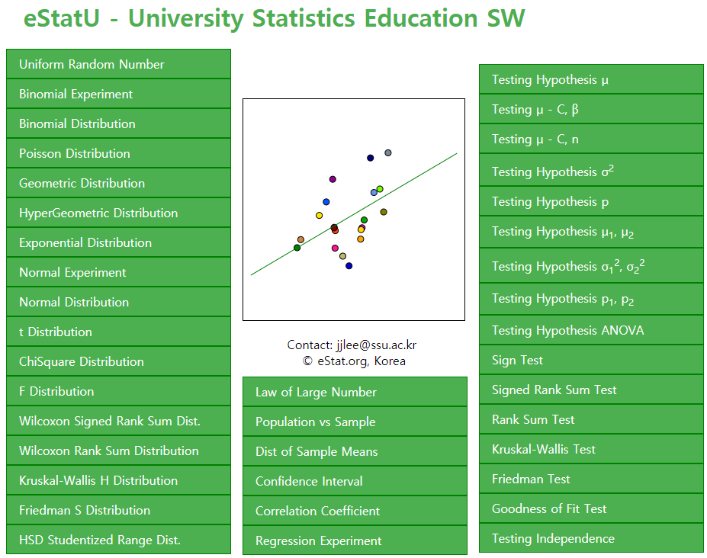
1.4 Software for Statistical Analysis - eStat

Slide 31
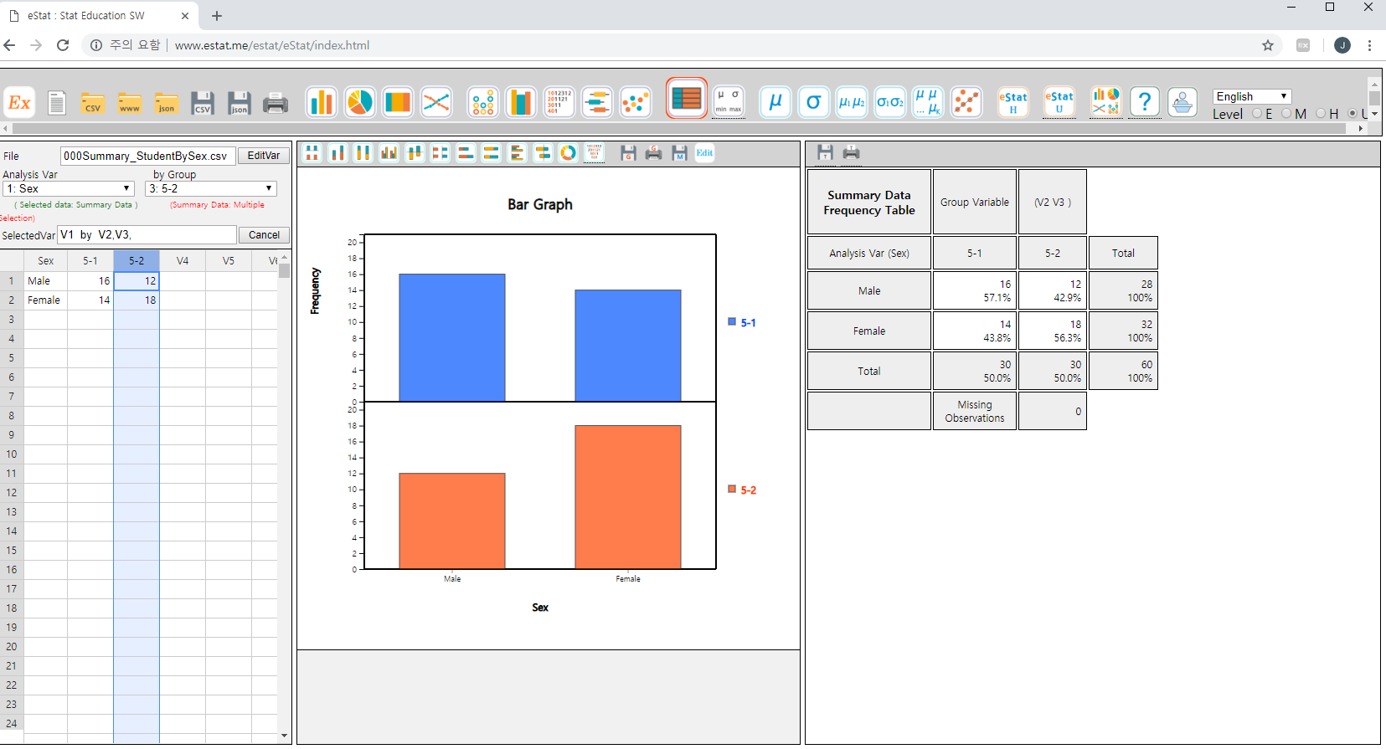
1.4 Software for Statistical Analysis - eStat
Language Selection
Easy UI - Icon only design
Examples
Level Selection
Easy UI – mouse clicking only
Log Window
Dynamic graph

Slide 32
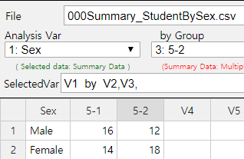
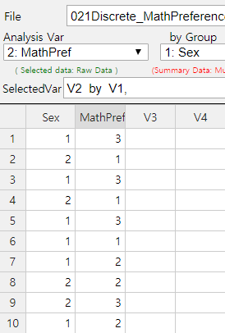
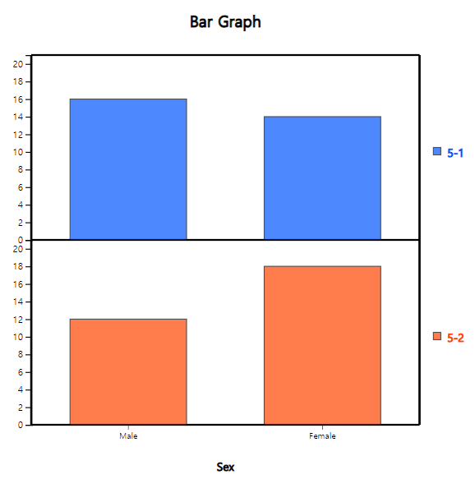
1.4 Software for Statistical Analysis - eStat
◎ Data and Dynamic Graph
Support csv and json format
Support summary and raw data for data processing
Dynamic graph

Slide 33
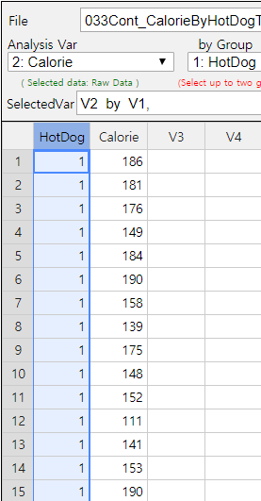
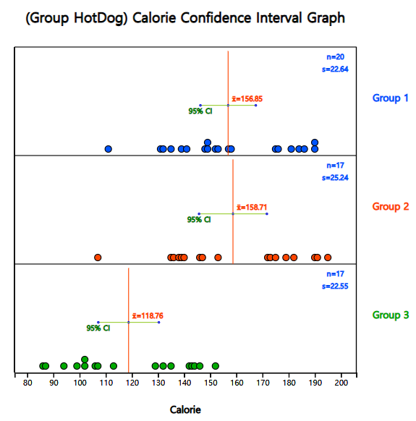
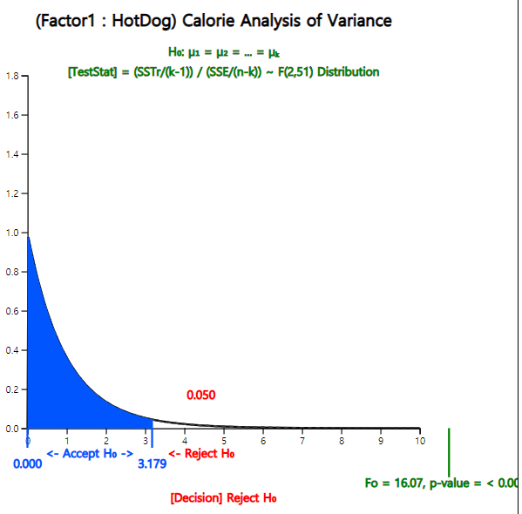
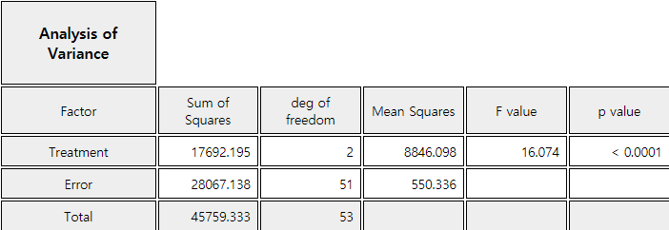
1.4 Software for Statistical Analysis - eStat
◎ Graphical Result of Statistical Analysis - ANOVA

Slide 34
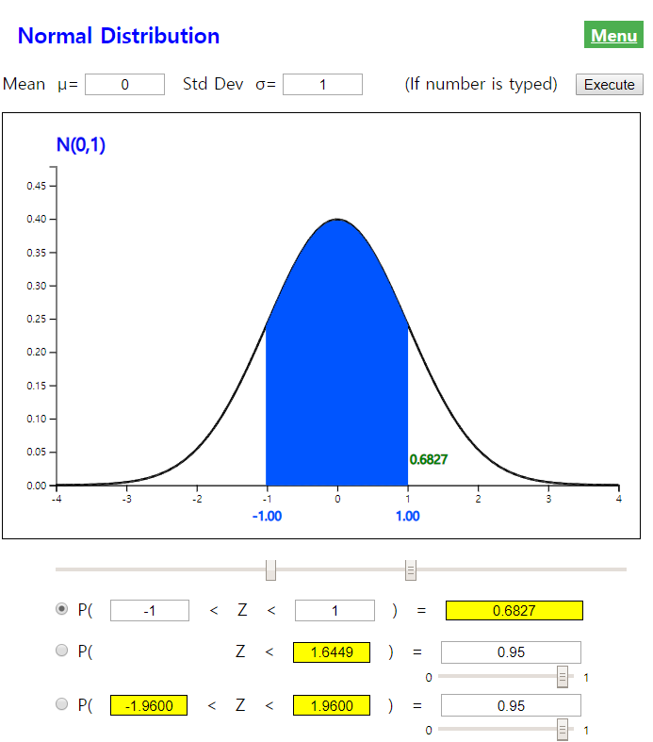
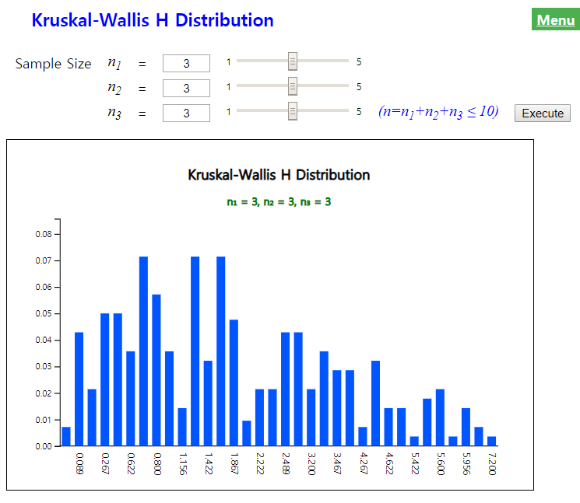
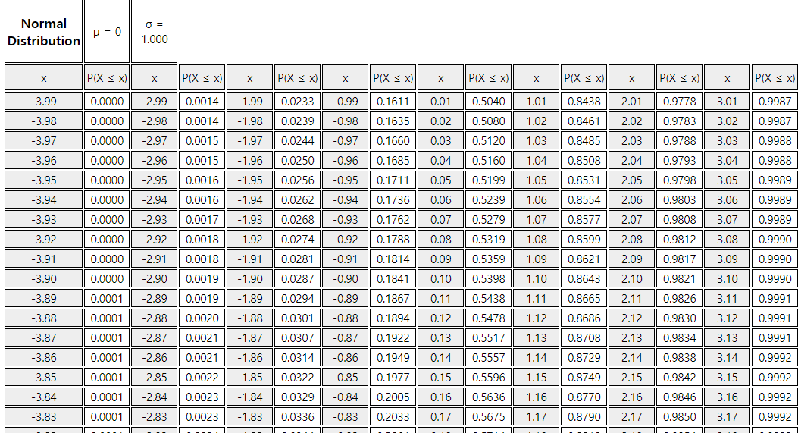
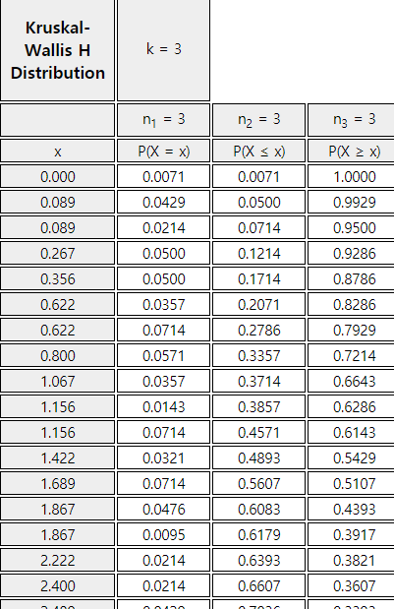
1.4 Software for Statistical Analysis - eStat
◎ All tables of statistical distributions are on smart-phone

Slide 35
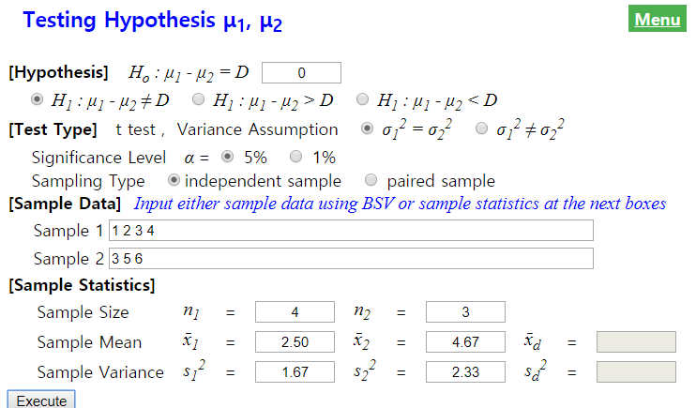
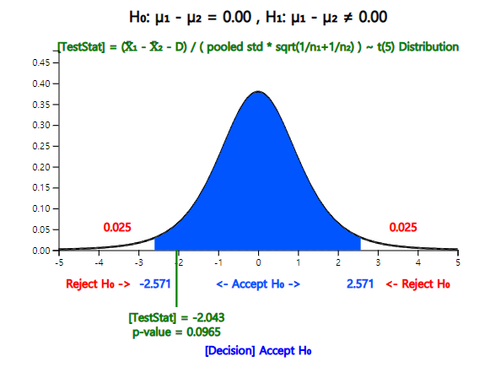
1.4 Software for Statistical Analysis - eStat
◎ Modules for Home Work Assignment - eStatU

Slide 36
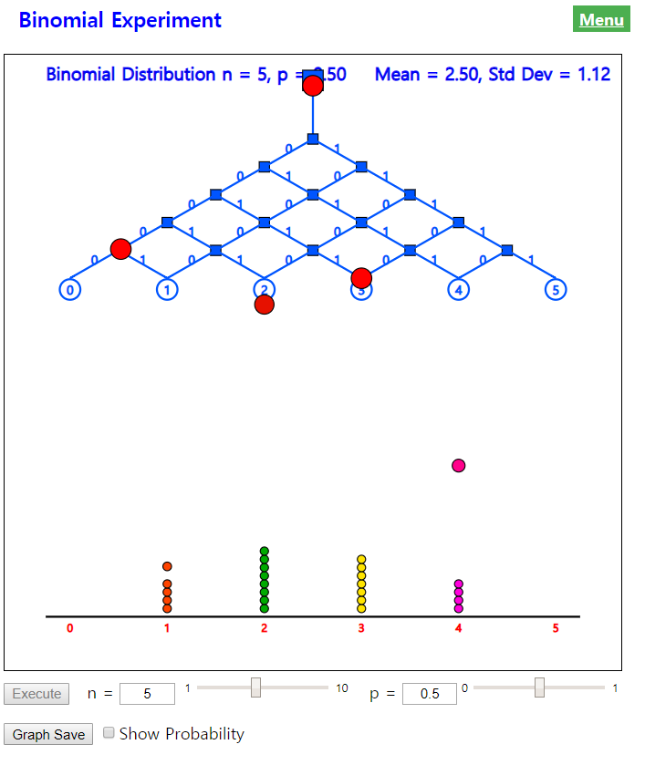
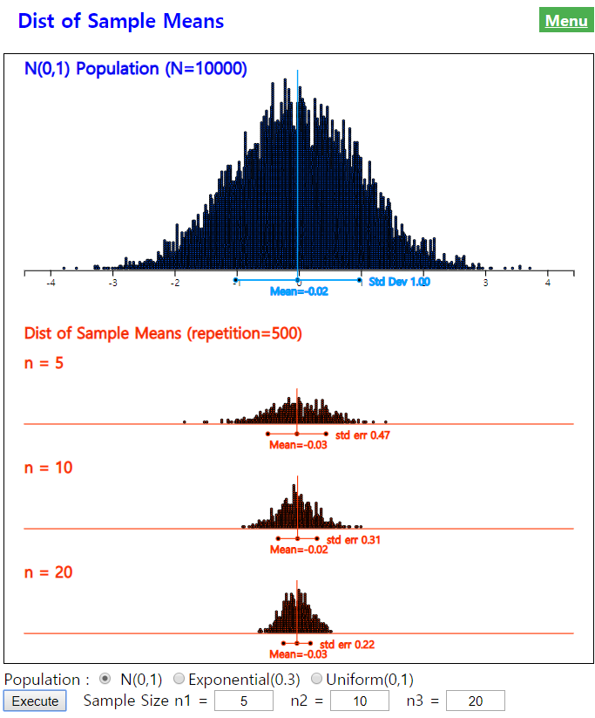
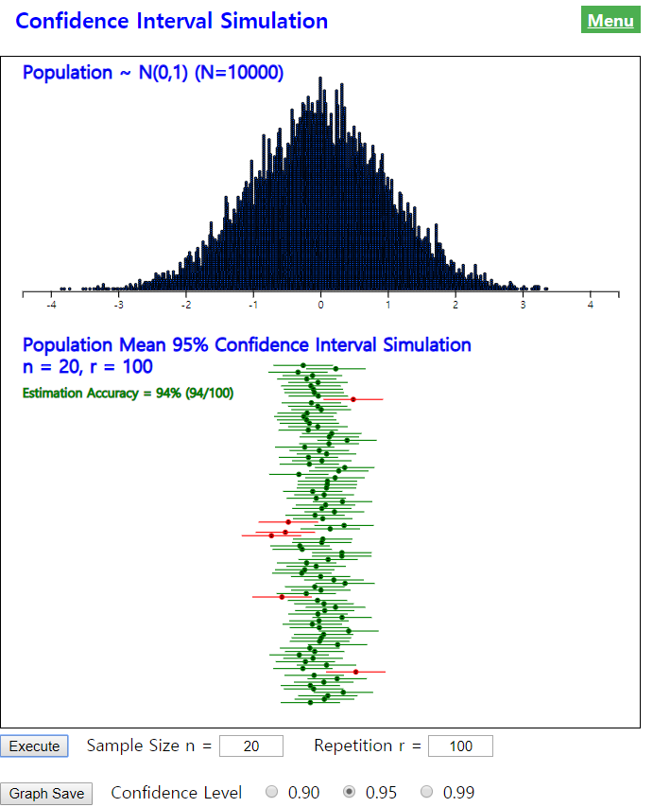
1.4 Software for Statistical Analysis - eStat
◎ Simulation Experiments

Slide 37
1.4 Software for Statistical Analysis - eStat
http://www.estat.me
eStat works 100% with Chrome
Enter system
Data input/save/open
Draw graph and data analysis
Save results / print results
Log out the system
Educational modules
Others

Slide 38
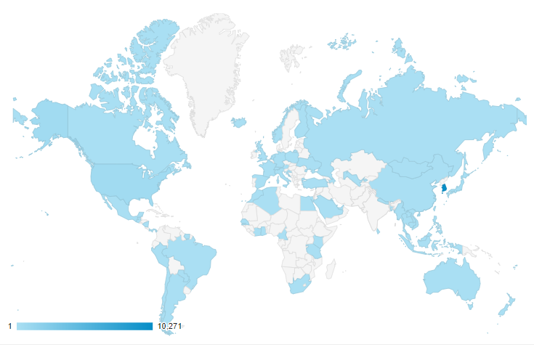
1.5 Summary
Statistics : long history to manage an organization
Introductory Statistics toward Data Science Using eStat
- data visualization, data summary
- probability, distribution function, estimation
- testing hypothesis, regression
eStat is an educational statistical software
- web/mobile based, easy UI, dynamic graph
- from elementary school to university
- freeware, multilingual
eStat is widely used in the world
- USCOTS, JINSE(Japan) recommended

Slide 39
Çox sağ ol !

